Slide 1

Naive Bayes Classifier
Presented by:
Elizer Ponio Jr.
Department of Computer Science
College of Computing and Information Technologies

Slide 2
Outline
Spam Filter Demo
Advantages and Disadvantages of Naïve Bayes
Types of Naïve Bayes Classifiers
Appendices

Slide 3


Imagine if we have a dataset composed of email messages you collected from your email account

Slide 4
From the 12 email messages you have collected, 8 are normal messages

Slide 5
And 4 are spam messages (email messages usually from unwanted advertisements)

Slide 6
And you have decided to build your own spam filter system

Slide 7

The first thing we need to do is to count all of the words that occur in the normal messages.

Slide 9
We can use this chart to calculate the probabilities of seeing each word, given that it is a normal message

Slide 10
For example, the probability we see the word “Dear”, given the we saw it in a normal message

Slide 11
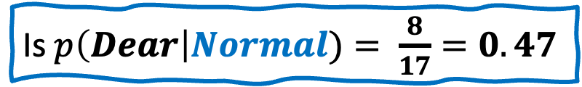
Is $p\left(Dear\right|Normal)= \frac{8}{17}=0.47$
Where 8 is the number of times “Dear” occurred in normal messages divided by 17, the total number of words in all normal messages

Slide 12
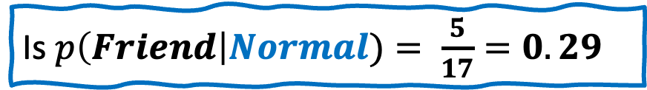
Is $p\left(Friend\right|Normal)= \frac{5}{17}=0.29$
Likewise, the probability the we see the word “Friend” given that we saw it in normal messages is 0.29

Slide 13

Is $p\left(Lunch\right|Normal)= \frac{3}{17}=0.18$
The probability the we see the word “Lunch” given that we saw it in normal messages is 0.18

Slide 14
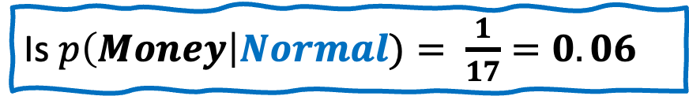
Is $p\left(Money\right|Normal)= \frac{1}{17}=0.06$
The probability the we see the word “Money” given that we saw it in normal messages is 0.06

Slide 15

Now we count all the words that occur in the spam…

Slide 16
We can also use this chart to calculate the probabilities of seeing each word, given that it is a spam message

Slide 17
For example, the probability we see the word “Dear”, given the we saw it in a spam message

Slide 18
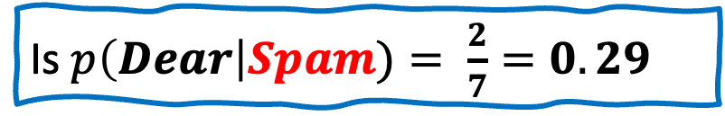
Is $p\left(Dear\right|Spam)= \frac{2}{7}=0.29$
Where 2 is the number of times “Dear” occurred in spam divided by 7, the total number of words in all spam messages

Slide 19

Is $p\left(Friend\right|Spam)= \frac{1}{7}=0.14$
We also calculate the probability for ”Friend” in spam

Slide 20

Is $p\left(Lunch\right|Spam)= \frac{0}{7}=0.00$
We also calculate the probability for ”Lunch” in spam

Slide 21
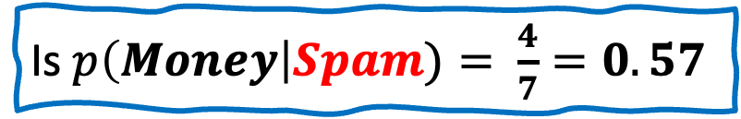
Is $p\left(Money\right|Spam)= \frac{4}{7}=0.57$
We also calculate the probability for ”Money” in spam

Slide 22








$$p\left(Dear\right|Normal)= 0.47$$
$$p\left(Dear\right|Spam)= 0.29$$
$$p\left(Friend\right|Normal)= 0.29$$
$$p\left(Friend\right|Spam)= 0.14$$
$$p\left(Lunch\right|Normal)= 0.18$$
$$p\left(Lunch\right|Spam)= 0.0$$
$$p\left(Money\right|Normal)= 0.06$$
$$p\left(Money\right|Spam)= 0.57$$
Now imagine if we get a new message that said “Dear Friend” and we want to classify if it is a normal message or spam message

Slide 23
$$p\left(Dear\right|Normal)= 0.47$$
$$p\left(Dear\right|Spam)= 0.29$$
$$p\left(Friend\right|Normal)= 0.29$$
$$p\left(Friend\right|Spam)= 0.14$$
$$p\left(Lunch\right|Normal)= 0.18$$
$$p\left(Lunch\right|Spam)= 0.0$$
$$p\left(Money\right|Normal)= 0.06$$
$$p\left(Money\right|Spam)= 0.57$$
We start with an initial guess about the probability that any message, regardless of what it says, is a normal message

Slide 24
$$p\left(Dear\right|Normal)= 0.47$$
$$p\left(Dear\right|Spam)= 0.29$$
$$p\left(Friend\right|Normal)= 0.29$$
$$p\left(Friend\right|Spam)= 0.14$$
$$p\left(Lunch\right|Normal)= 0.18$$
$$p\left(Lunch\right|Spam)= 0.0$$
$$p\left(Money\right|Normal)= 0.06$$
$$p\left(Money\right|Spam)= 0.57$$
The guess can be any probability that we want, but a common guess is estimated from the training data.

Slide 25
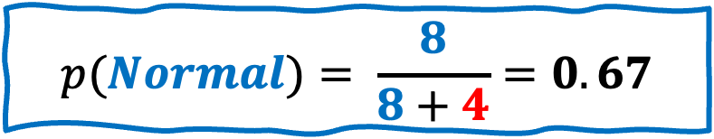
$$p\left(Dear\right|Normal)= 0.47$$
$$p\left(Dear\right|Spam)= 0.29$$
$$p\left(Friend\right|Normal)= 0.29$$
$$p\left(Friend\right|Spam)= 0.14$$
$$p\left(Lunch\right|Normal)= 0.18$$
$$p\left(Lunch\right|Spam)= 0.0$$
$$p\left(Money\right|Normal)= 0.06$$
$$p\left(Money\right|Spam)= 0.57$$
For example, since 8 out of 12 messages are normal messages, our initial guess would be 0.67
$$p(Normal)= \frac{8}{8+4}=0.67$$

Slide 26

$$p\left(Dear\right|Normal)= 0.47$$
$$p\left(Dear\right|Spam)= 0.29$$
$$p\left(Friend\right|Normal)= 0.29$$
$$p\left(Friend\right|Spam)= 0.14$$
$$p\left(Lunch\right|Normal)= 0.18$$
$$p\left(Lunch\right|Spam)= 0.0$$
$$p\left(Money\right|Normal)= 0.06$$
$$p\left(Money\right|Spam)= 0.57$$
$$p(Normal)= 0.67$$
This is also called Prior Probability

Slide 27


$$p\left(Dear\right|Normal)= 0.47$$
$$p\left(Dear\right|Spam)= 0.29$$
$$p\left(Friend\right|Normal)= 0.29$$
$$p\left(Friend\right|Spam)= 0.14$$
$$p\left(Lunch\right|Normal)= 0.18$$
$$p\left(Lunch\right|Spam)= 0.0$$
$$p\left(Money\right|Normal)= 0.06$$
$$p\left(Money\right|Spam)= 0.57$$
$$p(Normal)= 0.67$$
Now we multiply the initial guess by the probability that the word “Dear” occurs in a normal message
$$p\left(Normal\right)∗p\left(Dear \right|Normal)$$

Slide 28
$$p\left(Dear\right|Normal)= 0.47$$
$$p\left(Dear\right|Spam)= 0.29$$
$$p\left(Friend\right|Normal)= 0.29$$
$$p\left(Friend\right|Spam)= 0.14$$
$$p\left(Lunch\right|Normal)= 0.18$$
$$p\left(Lunch\right|Spam)= 0.0$$
$$p\left(Money\right|Normal)= 0.06$$
$$p\left(Money\right|Spam)= 0.57$$
$$p(Normal)= 0.67$$
And the probability that the word “Friend” occurs in a normal message
$$p\left(Normal\right)∗p\left(Dear \right|Normal) ∗p\left(Friend\right|Normal)$$

Slide 29


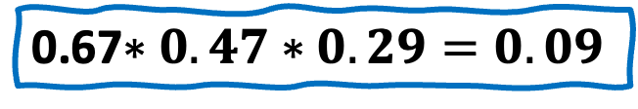
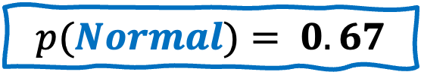
$$p\left(Dear\right|Normal)= 0.47$$
$$p\left(Dear\right|Spam)= 0.29$$
$$p\left(Friend\right|Normal)= 0.29$$
$$p\left(Friend\right|Spam)= 0.14$$
$$p\left(Lunch\right|Normal)= 0.18$$
$$p\left(Lunch\right|Spam)= 0.0$$
$$p\left(Money\right|Normal)= 0.06$$
$$p\left(Money\right|Spam)= 0.57$$
$$p(Normal)= 0.67$$
Plug in the numbers and we get
0.67$∗0.47∗0.29=0.09$

Slide 30
$$p\left(Dear\right|Normal)= 0.47$$
$$p\left(Dear\right|Spam)= 0.29$$
$$p\left(Friend\right|Normal)= 0.29$$
$$p\left(Friend\right|Spam)= 0.14$$
$$p\left(Lunch\right|Normal)= 0.18$$
$$p\left(Lunch\right|Spam)= 0.0$$
$$p\left(Money\right|Normal)= 0.06$$
$$p\left(Money\right|Spam)= 0.57$$
$$p(Normal)= 0.67$$
Now, just like what we did before, we start with an initial guess about the probability that any message, regardless of what it says, is spam

Slide 31
$$p\left(Dear\right|Normal)= 0.47$$
$$p\left(Dear\right|Spam)= 0.29$$
$$p\left(Friend\right|Normal)= 0.29$$
$$p\left(Friend\right|Spam)= 0.14$$
$$p\left(Lunch\right|Normal)= 0.18$$
$$p\left(Lunch\right|Spam)= 0.0$$
$$p\left(Money\right|Normal)= 0.06$$
$$p\left(Money\right|Spam)= 0.57$$
$$p(Normal)= 0.67$$
The guess can be any probability that we want, but a common guess is estimated from the training data.

Slide 32
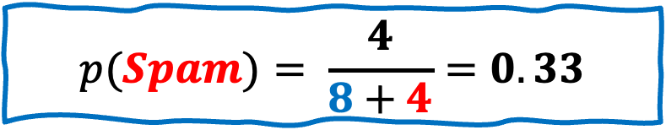
$$p\left(Dear\right|Normal)= 0.47$$
$$p\left(Dear\right|Spam)= 0.29$$
$$p\left(Friend\right|Normal)= 0.29$$
$$p\left(Friend\right|Spam)= 0.14$$
$$p\left(Lunch\right|Normal)= 0.18$$
$$p\left(Lunch\right|Spam)= 0.0$$
$$p\left(Money\right|Normal)= 0.06$$
$$p\left(Money\right|Spam)= 0.57$$
$$p(Normal)= 0.67$$
Since 4 out of 12 messages are spam messages, our initial guess would be 0.33
$$p(Spam)= \frac{4}{8+4}=0.33$$

Slide 33




$$p\left(Dear\right|Normal)= 0.47$$
$$p\left(Dear\right|Spam)= 0.29$$
$$p\left(Friend\right|Normal)= 0.29$$
$$p\left(Friend\right|Spam)= 0.14$$
$$p\left(Lunch\right|Normal)= 0.18$$
$$p\left(Lunch\right|Spam)= 0.0$$
$$p\left(Money\right|Normal)= 0.06$$
$$p\left(Money\right|Spam)= 0.57$$
$$p(Normal)= 0.67$$
$$p(Spam)=0.33$$
Now we multiply the initial guess by the probability that the word “Dear” occurs in a spam message
$$p\left(Spam\right)∗p\left(Dear \right|Spam)$$

Slide 34
$$p\left(Dear\right|Normal)= 0.47$$
$$p\left(Dear\right|Spam)= 0.29$$
$$p\left(Friend\right|Normal)= 0.29$$
$$p\left(Friend\right|Spam)= 0.14$$
$$p\left(Lunch\right|Normal)= 0.18$$
$$p\left(Lunch\right|Spam)= 0.0$$
$$p\left(Money\right|Normal)= 0.06$$
$$p\left(Money\right|Spam)= 0.57$$
$$p(Normal)= 0.67$$
$$p(Spam)=0.33$$
And the probability that the word “Friend” occurs in a spam message
$$p\left(Spam\right)∗p\left(Dear \right|Spam) ∗p(Friend|Spam)$$

Slide 35
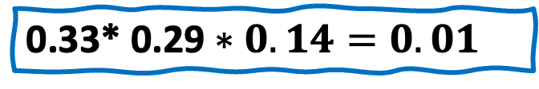
$$p\left(Dear\right|Normal)= 0.47$$
$$p\left(Dear\right|Spam)= 0.29$$
$$p\left(Friend\right|Normal)= 0.29$$
$$p\left(Friend\right|Spam)= 0.14$$
$$p\left(Lunch\right|Normal)= 0.18$$
$$p\left(Lunch\right|Spam)= 0.0$$
$$p\left(Money\right|Normal)= 0.06$$
$$p\left(Money\right|Spam)= 0.57$$
$$p(Normal)= 0.67$$
$$p(Spam)=0.33$$
Plug in the numbers and we get
0.33* 0.29 $∗0.14=0.01$

Slide 36
$$p\left(Dear\right|Normal)= 0.47$$
$$p\left(Dear\right|Spam)= 0.29$$
$$p\left(Friend\right|Normal)= 0.29$$
$$p\left(Friend\right|Spam)= 0.14$$
$$p\left(Lunch\right|Normal)= 0.18$$
$$p\left(Lunch\right|Spam)= 0.0$$
$$p\left(Money\right|Normal)= 0.06$$
$$p\left(Money\right|Spam)= 0.57$$
$$p(Normal)= 0.67$$
$$p(Spam)=0.33$$
Now, we compare both probabilities!
$$p\left(Normal\right)∗p\left(Dear \right|Normal) ∗p\left(Friend\right|Normal)=0.09$$
$$p\left(Spam\right)∗p\left(Dear \right|Spam) ∗p(Friend\left|Spam\right)=0.01$$

Slide 37
$$p\left(Dear\right|Normal)= 0.47$$
$$p\left(Dear\right|Spam)= 0.29$$
$$p\left(Friend\right|Normal)= 0.29$$
$$p\left(Friend\right|Spam)= 0.14$$
$$p\left(Lunch\right|Normal)= 0.18$$
$$p\left(Lunch\right|Spam)= 0.0$$
$$p\left(Money\right|Normal)= 0.06$$
$$p\left(Money\right|Spam)= 0.57$$
$$p(Normal)= 0.67$$
$$p(Spam)=0.33$$
Because 0.09 > 0.01, we will classify “Dear Friend” as a normal message
$$p\left(Normal\right)∗p\left(Dear \right|Normal) ∗p\left(Friend \right|Normal)=0.09$$
$$p\left(Spam\right)∗p\left(Dear \right|Spam) ∗p(Friend\left|Spam\right)=0.01$$

Slide 38
Now let us talk about why Naïve Bayes is naive

Slide 39
$$p\left(Dear\right|Normal)= 0.47$$
$$p\left(Friend\right|Normal)= 0.29$$
$$p\left(Lunch\right|Normal)= 0.18$$
The thing that makes Naives Bayes so naïve is that it treats all word orders the same.
$$p\left(Money\right|Normal)= 0.06$$
$$p(Normal)= 0.67$$

Slide 40
$$p\left(Dear\right|Normal)= 0.47$$
$$p\left(Friend\right|Normal)= 0.29$$
$$p\left(Lunch\right|Normal)= 0.18$$
$$p\left(Money\right|Normal)= 0.06$$
$$p(Normal)= 0.67$$
For example, the score for “Dear Friend”
$$p\left(Normal\right)∗p\left(Dear \right|Normal) ∗p\left(Friend \right|Normal)=0.09$$

Slide 41
$$p\left(Dear\right|Normal)= 0.47$$
$$p\left(Friend\right|Normal)= 0.29$$
$$p\left(Lunch\right|Normal)= 0.18$$
$$p\left(Money\right|Normal)= 0.06$$
$$p(Normal)= 0.67$$
Is exactly the same score for “Friend Dear”
$$p\left(Normal\right)∗p\left(Dear \right|Normal) ∗p\left(Friend \right|Normal)=0.09$$
$$p\left(Normal\right)∗p\left(Friend \right|Normal) ∗p\left(Dear \right|Normal)=0.09$$

Slide 42
$$p\left(Dear\right|Normal)= 0.47$$
$$p\left(Friend\right|Normal)= 0.29$$
$$p\left(Lunch\right|Normal)= 0.18$$
$$p\left(Money\right|Normal)= 0.06$$
$$p(Normal)= 0.67$$
Every language has grammar, rules and word orders and Naïve Bayes ignores all of those

Slide 43
$$p\left(Dear\right|Normal)= 0.47$$
$$p\left(Friend\right|Normal)= 0.29$$
$$p\left(Lunch\right|Normal)= 0.18$$
$$p\left(Money\right|Normal)= 0.06$$
$$p(Normal)= 0.67$$
With that said, even though Naïve Bayes is naïve, it tends to perform surprisingly well for spam filters

Slide 44
Advantages of Naïve Bayes Classifier
Less complex: Compared to other classifiers, Naïve Bayes is considered a simpler classifier since the parameters are easier to estimate.
Scales well: Compared to logistic regression, Naïve Bayes is considered a fast and efficient classifier that is fairly accurate when the conditional independence assumption holds. It also has low storage requirements.
Can handle high-dimensional data: Use cases, such document classification, can have a high number of dimensions, which can be difficult for other classifiers to manage.

Slide 45
Disadvantages of Naïve Bayes Classifier
Subject to Zero frequency: Zero frequency occurs when a categorical variable does not exist within the training set. For example, imagine that we’re trying to find the maximum likelihood estimator for the word, “sir” given class “spam”, but the word, “sir” doesn’t exist in the training data. The probability in this case would zero, and since this classifier multiplies all the conditional probabilities together, this also means that posterior probability will be zero. To avoid this issue, laplace smoothing can be leveraged.
Unrealistic core assumption: While the conditional independence assumption overall performs well, the assumption does not always hold, leading to incorrect classifications.

Slide 46
Types of Naïve Bayes Classifier
There isn’t just one type of Naïve Bayes classifier. The most popular types differ based on the distributions of the feature values. Some of these include:
Gaussian Naïve Bayes (GaussianNB): This is a variant of the Naïve Bayes classifier, which is used with Gaussian distributions—i.e. normal distributions—and continuous variables. This model is fitted by finding the mean and standard deviation of each class.
Multinomial Naïve Bayes (MultinomialNB): This type of Naïve Bayes classifier assumes that the features are from multinomial distributions. This variant is useful when using discrete data, such as frequency counts, and it is typically applied within natural language processing use cases, like spam classification.
Bernoulli Naïve Bayes (BernoulliNB): This is another variant of the Naïve Bayes classifier, which is used with Boolean variables—that is, variables with two values, such as True and False or 1 and 0.

Slide 47
Appendices

Slide 48
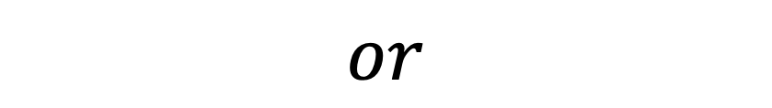
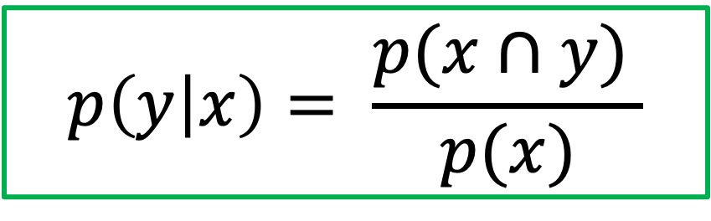
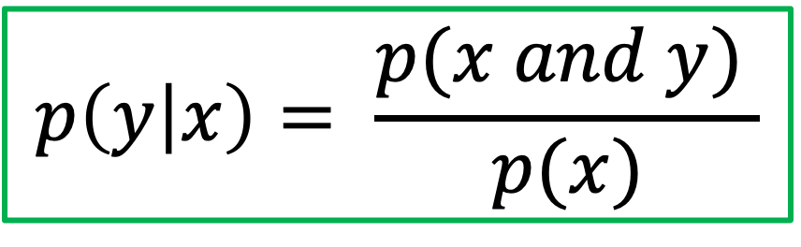
Conditional Probability
$$p\left(y | x\right)= \frac{p(x and y) }{p(x)}$$
$$or$$
$$p\left(y | x\right)= \frac{p(x∩y) }{p(x)}$$

Slide 49
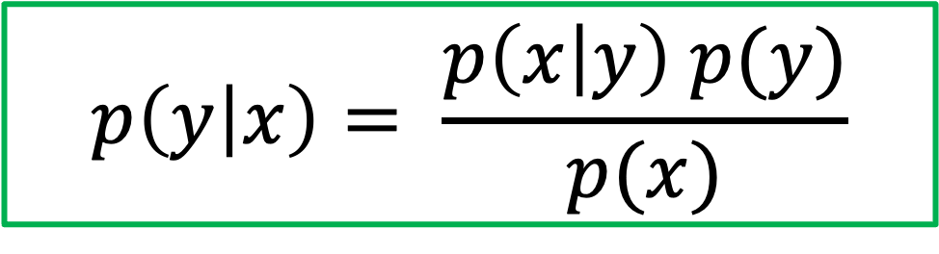
Bayes Theorem
$$p\left(y | x\right)= \frac{p\left(x | y\right) p(y)}{p(x)}$$

Slide 50
Naïve Bayes
Naïve Bayes classifiers work differently in that they operate under a couple of key assumptions, earning it the title of “naïve”.
It assumes that predictors in a Naïve Bayes model are conditionally independent, or unrelated to any of the other feature in the model.
It also assumes that all features contribute equally to the outcome. While these assumptions are often violated in real-world scenarios (e.g. a subsequent word in an e-mail is dependent upon the word that precedes it), it simplifies a classification problem by making it more computationally tractable. That is, only a single probability will now be required for each variable, which, in turn, makes the model computation easier. Despite this unrealistic independence assumption, the classification algorithm performs well, particularly with small sample sizes.

Slide 51
Naïve Bayes
With that assumption in mind, we can now reexamine the parts of a Naïve Bayes classifier more closely. Similar to Bayes’ Theorem, it’ll use conditional and prior probabilities to calculate the posterior probabilities using the following formula:
$$posterior probability= \frac{(conditional probabilty) (prior probability)}{evidence }$$

Slide 52
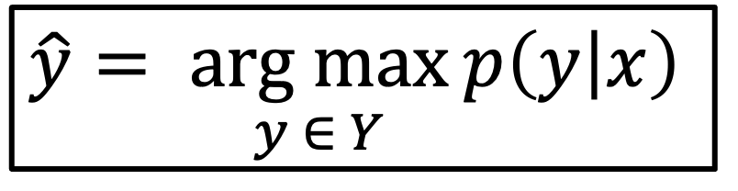
Naïve Bayes
Let’s imagine text classification use case to illustrate how the Naïve Bayes algorithm works. Picture an e-mail provider that is looking to improve their spam filter. The training data would consist of words from e-mails that have been classified as either “spam” or “not spam”. From there, the class conditional probabilities and the prior probabilities are calculated to yield the posterior probability. The Naïve Bayes classifier will operate by returning the class, which has the maximum posterior probability out of a group of classes (i.e. “spam” or “not spam”) for a given e-mail.
This calculation is represented with the following formula:
$$\hat{y}= \underset{y ∈ Y}{arg max}{p\left(y | x\right) }$$

Slide 53
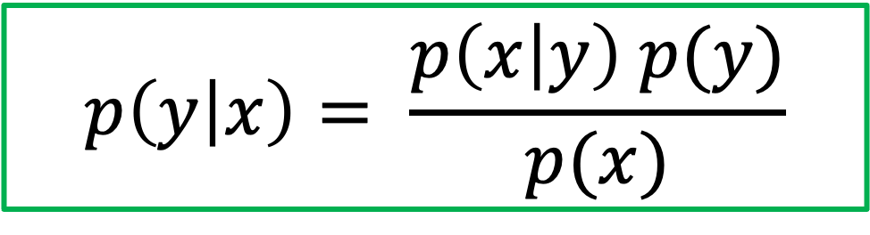
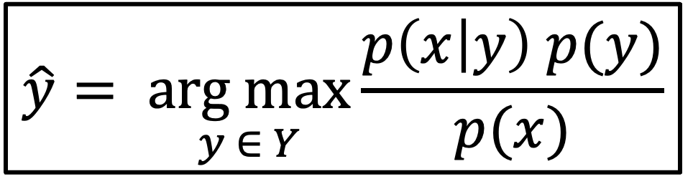
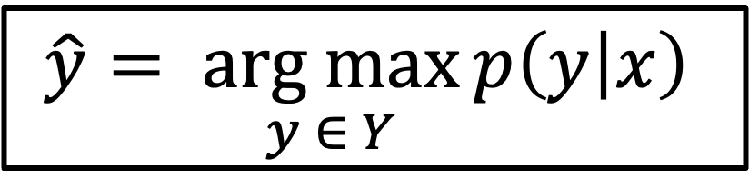
Naïve Bayes
$$\hat{y}= \underset{y ∈ Y}{arg max}{p\left(y | x\right) }$$
$$p\left(y | x\right)= \frac{p\left(x | y\right) p(y)}{p(x)}$$
$$\hat{y}= \underset{y ∈ Y}{arg max}{\frac{p\left(x | y\right) p(y)}{p(x)}}$$

Slide 54
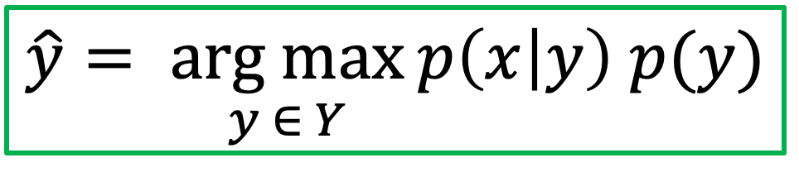
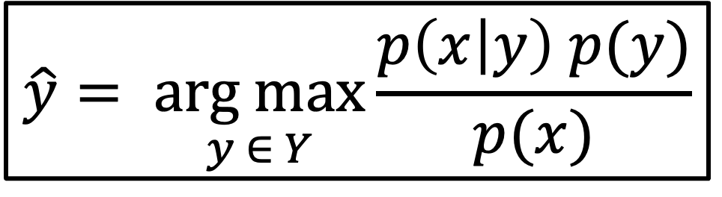
Naïve Bayes
$$\hat{y}= \underset{y ∈ Y}{arg max}{\frac{p\left(x | y\right) p(y)}{p(x)}}$$
Since each class is referring to the same piece of text, we can actually eliminate the denominator from this equation, simplifying it to:
$$\hat{y}= \underset{y ∈ Y}{arg max}{p\left(x | y\right) p(y)}$$

Slide 55
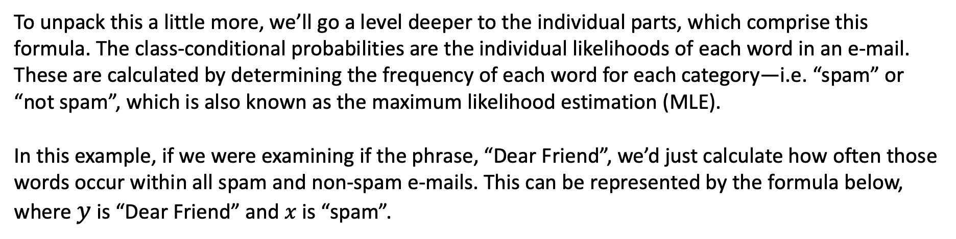
Class-conditional probabilities
To unpack this a little more, we’ll go a level deeper to the individual parts, which comprise this formula. The class-conditional probabilities are the individual likelihoods of each word in an e-mail. These are calculated by determining the frequency of each word for each category—i.e. “spam” or “not spam”, which is also known as the maximum likelihood estimation (MLE).
In this example, if we were examining if the phrase, “Dear Friend”, we’d just calculate how often those words occur within all spam and non-spam e-mails. This can be represented by the formula below, where $y$ is “Dear Friend” and $x$ is “spam”.
$$\hat{p}\left(y=Dear Friend | x=spam\right)= p\left(Dear \right| spam) ∗p\left(Friend \right| spam)$$

Slide 56
Prior probabilities
The prior probabilities are exactly what we described earlier with Bayes’ Theorem.
Based on the training set, we can calculate the overall probability that an e-mail is “spam” or “not spam”. The prior probability for class label, “spam”, would be represented within the following formula:
$$\hat{p}(spam)= \frac{number of spam messages in training set}{number of all messages in training set}$$

Slide 57
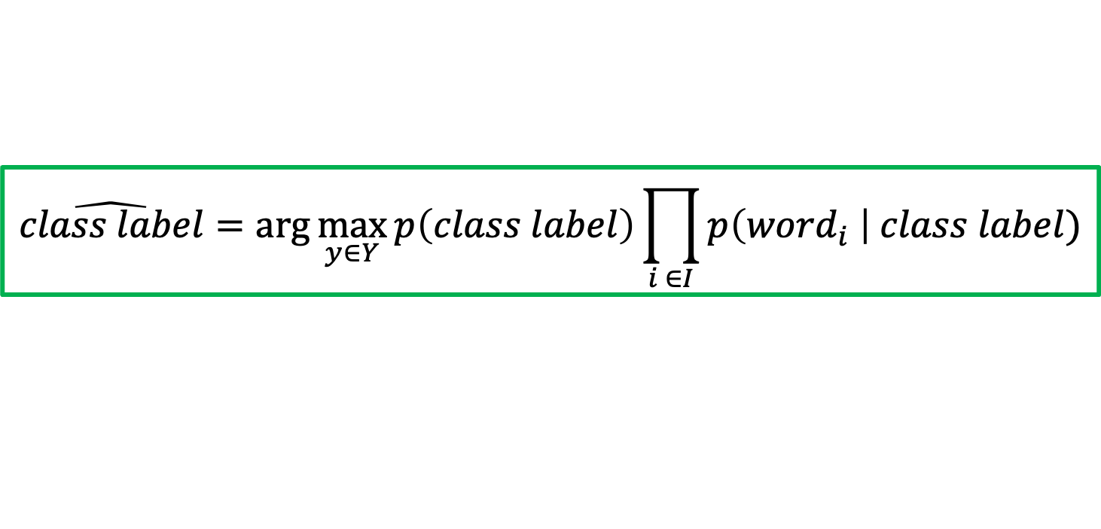
Prior probabilities
The prior probability acts as a “weight” to the class-conditional probability when the two values are multiplied together, yielding the individual posterior probabilities. From there, the maximum a posteriori (MAP) estimate is calculated to assign a class label of either spam or not spam.
The final equation for the Naïve Bayesian equation can be represented in the following ways:
$$\hat{class label}=\arg{\max_{y∈Y}{p\left(class label\right)\prod_{i ∈I}{p\left({word}_{i} \right| class label)}}}$$

Slide 58
References
https://www.youtube.com/watch?v=O2L2Uv9pdDA
https://www.ibm.com/topics/naive-bayes#:~:text=Naïve%20Bayes%20is%20part%20of,important%20to%20differentiate%20between%20classes.

